Slide 1

TUMOR DETECTION USING DIGITAL IMAGE PROCESSING
Submitted by:
SRINIVAS KASTURI (3078674)
DEC 20,2016

Slide 2
PROJECT IDEA
Each year more than 200,000 people in the United States are diagnosed with a primary or metastatic brain tumor.
The chances of surviving for a person with a brain tumor greatly depends on all of the following:
type of tumor
size of the extent
location of the tumor
presence or absence of metastasis

Slide 3

AUTHORS AND PROFESSORS
1) S. Murugavalli, V. Rajamani, “A high speed parallel fuzzy c-mean algorithm for brain tumour segmentation”,” BIME Journal.
2) Mohamed Lamine Toure, “Advanced Algorithm for Brain Segmentation using Fuzzy to Localize Cancer and Epilepsy Region”.
3) Dr.G.Padmavathi, Mr.M.Muthukumar and Mr. Suresh Kumar Thakur, “Non linear Image segmentation using fuzzy c means clustering method with thresholding for underwater images”.
4) W. Gonzalez, “Digital Image Processing”.

Slide 4
TABLE OF CONTENT
OBJECTIVE
INTRODUCTION
METHODOLOGY
RESULTS
ADVANTAGES
CONCLUSION
FUTURE SCOPE

Slide 5
OBJECTIVE
To detect the tumor and location of brain tumors from the Magnetic Resonance Images using Digital Image Processing.

Slide 6
INTRODUCTION
Brain tumor is an abnormal mass of tissue in which cells grow and multiply uncontrollably seemingly unchecked by the mechanisms that control normal cells.
This change detection process uses a novel score function based on Bhattacharya coefficient computed with gray level intensity histograms.
The score function admits a very fast search to locate the bounding box.

Slide 8
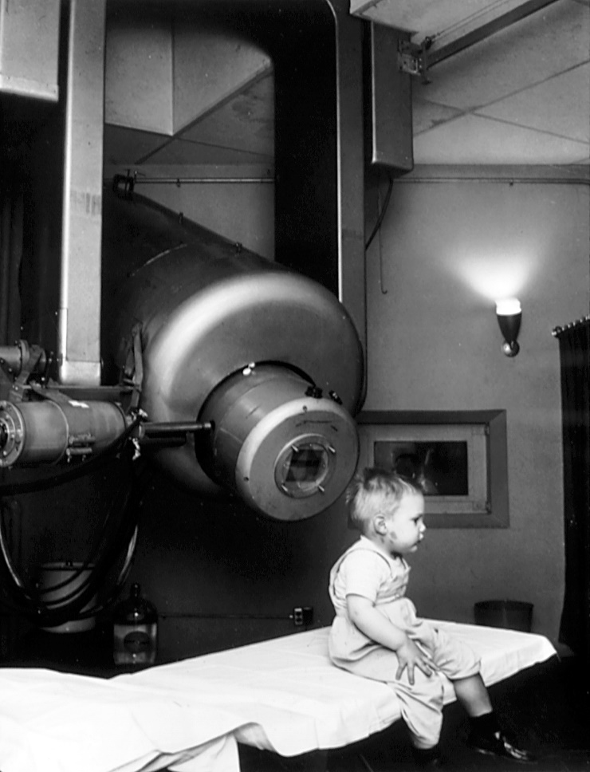
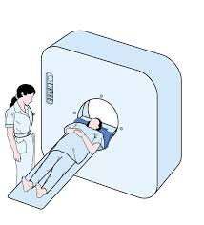
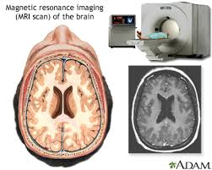
MRI scan
Fig-www.tumorsegmentation.org,www.radiopedia.org

Slide 9
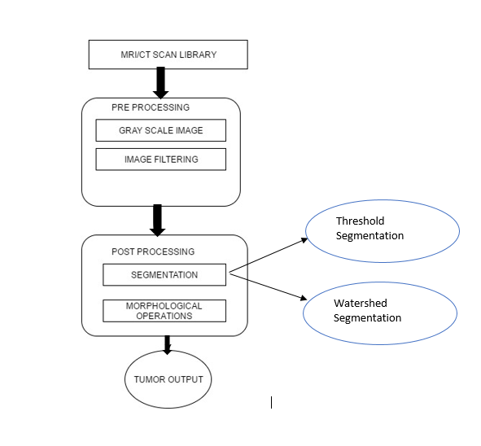
Workflow

Slide 10
Methodology
Gray scale imaging
Histogram equalization
High pass filter
Threshold segmentation
Morphological operation
Image subtraction

Slide 11
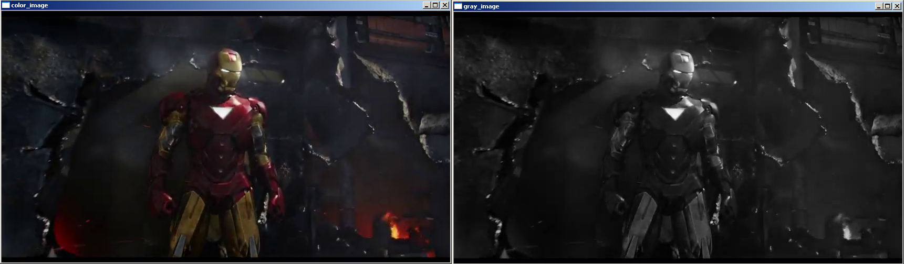
Grayscale imaging
Gray scale imaging is called as black and white image and it can also be called as halftone image so obtained by considering the images as a grid of black dots on white background.
Also because there are 8 bits in binary representation of the gray level ,so this method is also called 8-bitgrayscale.also it can be used in the preprocessing step of image segmentation to improve upon the contrasted image

Slide 12
Histogram equalization
Histogram are constructed by splitting the range of the data into equal-sized bins (called classes). Then for each bin, the number of points from the data set that fall into each bin are counted.
Vertical axis: Frequency (i.e., counts for each bin)
Horizontal axis: Response variable.
In image histograms the pixels form the horizontal axis
In Matlab histograms for images can be constructed using the imhist command.
Histogram equalization is a gray level transformation that results in an image may have a flat or peaked histogram.by this global contrast histogram of the image scan be improved. Also it accomplishes this by spreading out the most frequent intensity values

Slide 13
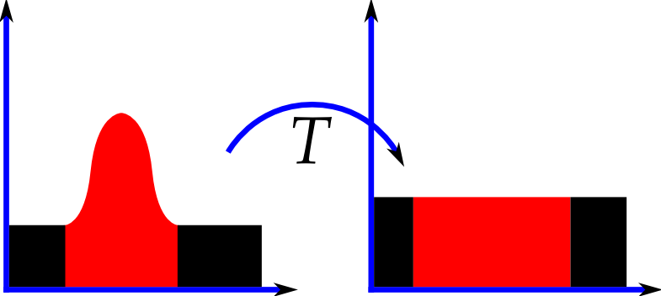
Histogram equalization ex:

Slide 14

High Pass Filter
High pass filter is used to do the sharpening of the images to the gray scale images. Sharpening is used to get the fine details of the image highlighted. Also it is used for edge detection.
These filters sharpens images by creating a high contrast overlay that emphasis edge in the image ,so also we can say that enhanced image is the result of addition of original image and the scaled version of the line structure and edges in the image.
High pass filter is also used to retain the frequency information within the image.

Slide 15
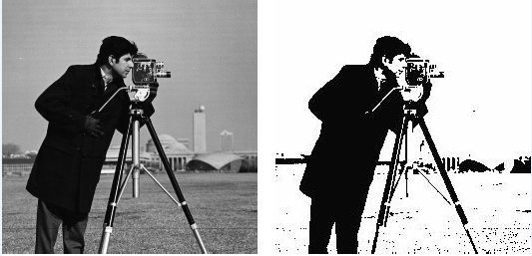
Threshold segmentation
Segmentation is the process of partitioning the images into multiple segments.(set of pixels).
Image segmentation is typically used to locate the objects and boundaries(lines,curves) in the images also we can say assigning the label to each pixels in an image such that pixels share same label to view the visual characteristics.
Threshold method is based on the threshold value to turn a grayscale image into a binary image.

Slide 16
WATERSHED SEGMENTATION

Slide 17
Morphological operation
Morphology refers to the description of the properties of the shape and structure of the objects.here binary images consists of various imperfections .thresholding are distorted by the noise and texture featurs.
Morphological operations are logical transformation based on the comparision of the pixel neighbourhood with a pattern.
These operations are usually performed on the binary images where the pixels values is between 0 and 1.

Slide 18
Image subtraction
Here in image subtraction operators takes two images as input and produce as output a third image ,whose pixels values are the values obtained by subtraction between the two images.
Here in this technique the tumor is extracted based on the closely packed pixels present in the image.by this tumor is removed.

Slide 19
Morphological operations have proved very helpful in extraction and filtering techniques where operators like open,spur,dilate,erode and close have proved to be helpful in extracting the brain tumor from MRI brain images.
Image subtraction technique proved to be helpful along with threshold segmentation to work for the desired region of the image.

Slide 20
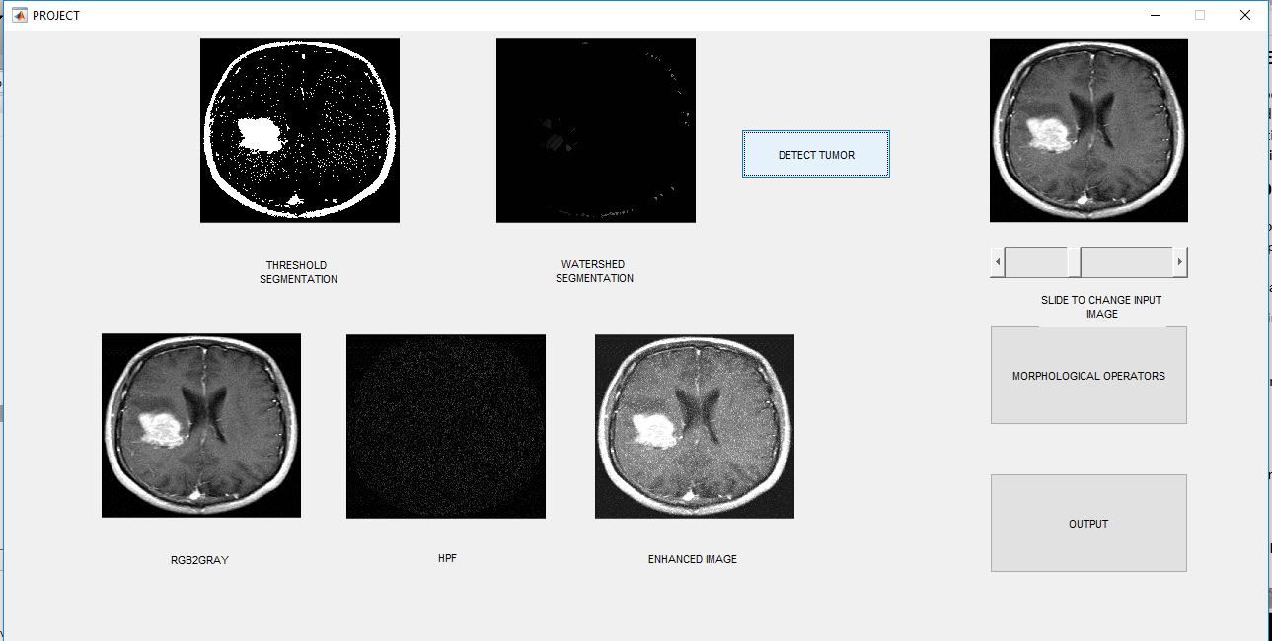
RESULTS

Slide 21
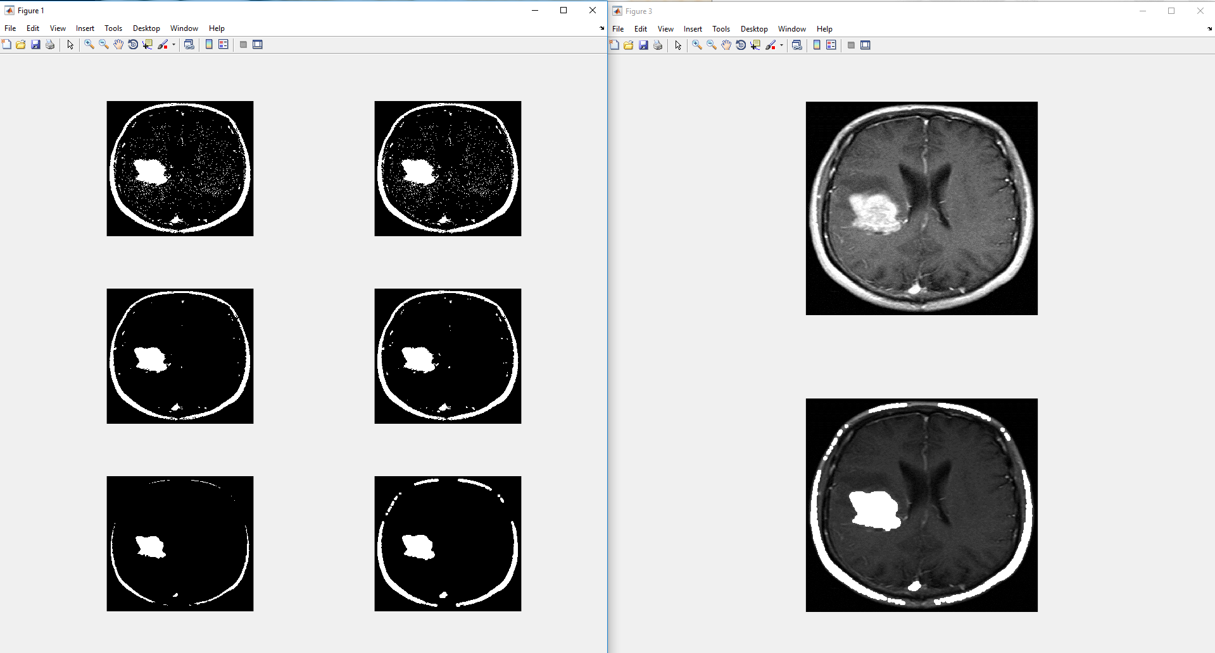

Slide 22
ADVANTAGES
1. Uses region-based left-right symmetry, rather than point-wise symmetry
2. Uses single MR image
3. No training data required
4. No image registration needed

Slide 23
CONCLUSION
The current method uses a computer aided system for brain MR image segmentation for detection of tumour location using bounding box symmetry.
The resulting method is very fast, robust and reliable for indexing tumour or edema images for both archival and retrieval purposes and it can use as a vehicle for further clinical investigations.

Slide 24
FUTURE SCOPE
In future, this technique can be developed to classify the tumours based on feature extraction.
This technique can be applied for ovarian, breast, lung, skin tumors.
Instead of rectangular boxes, can work with general boundaries: level set based framework.

